Slide 1
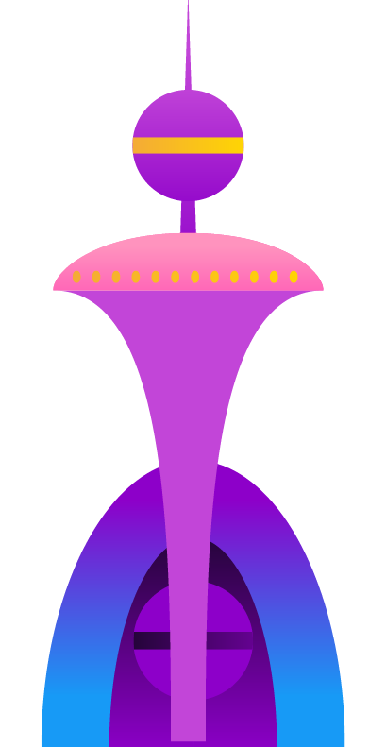

Utopia
Of 2L Co
Here is where your presentation begins

Slide 2
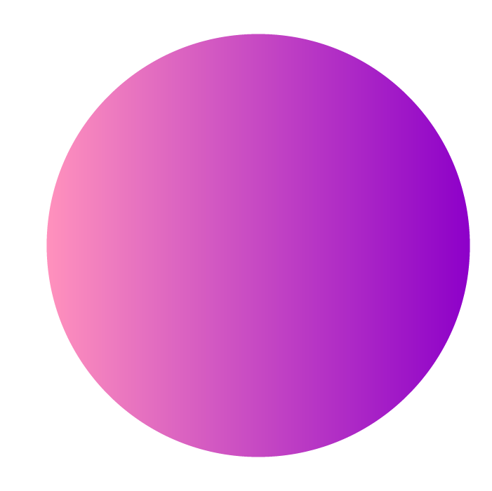
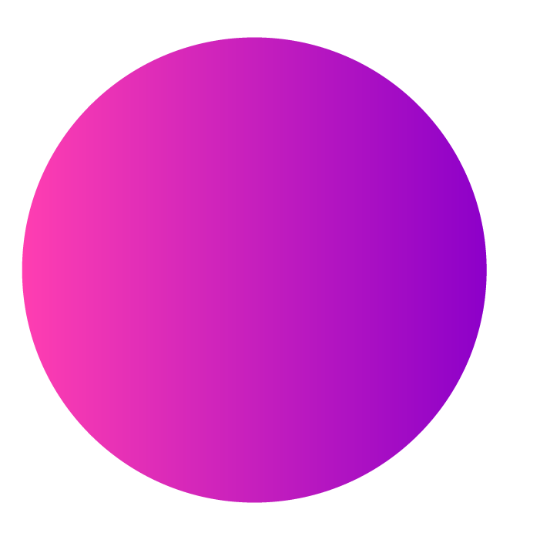
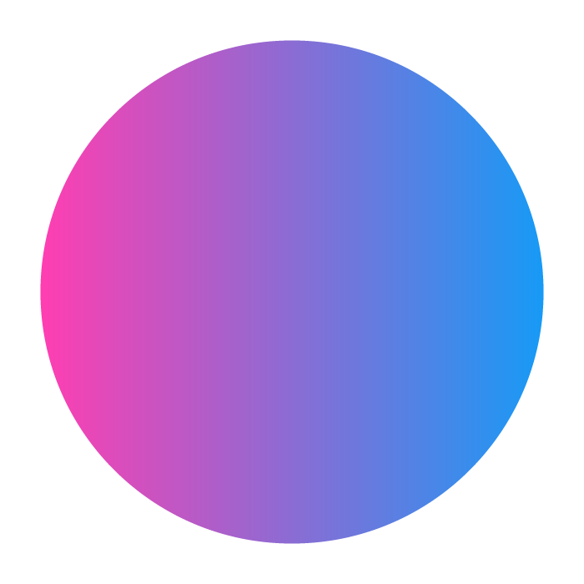


Table of contents
01
02
03
04
Introduction
Fields
Fields
Our fluent introducers introduce you to our Utopia
We introduce to you what out fields are
Each field presents ther part of the work
Conclusions
Concluding this presentation

Slide 3
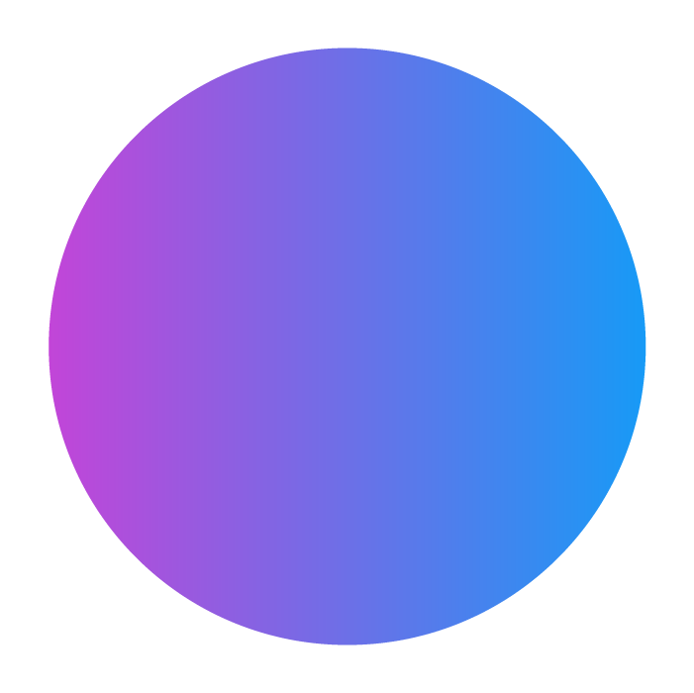

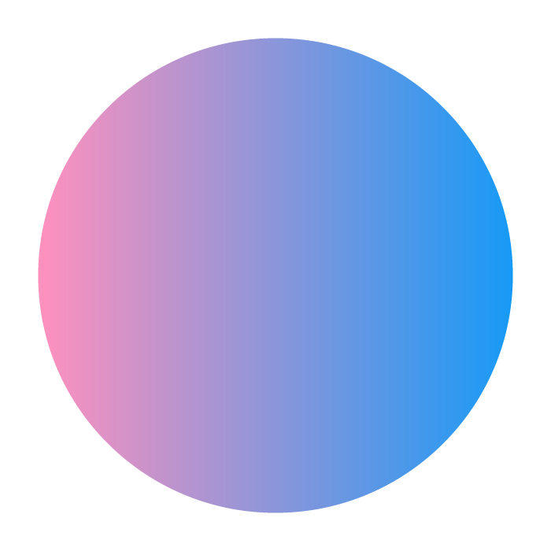
Our fields
Economics
Education
Architecture
Technology
Health

Slide 4
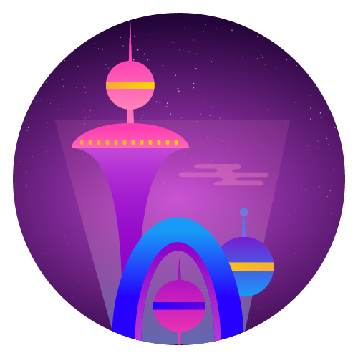
Introduction
You can give a brief description of the topic you want to talk about here. For example, if you want to talk about Mercury, you can say that it’s the smallest planet in the entire Solar System
Notes:
NADA

Slide 5

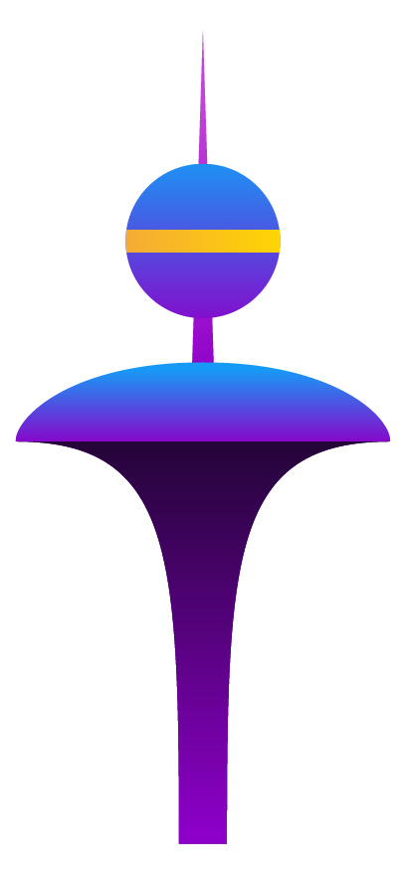
01
Education

Slide 6
02
Economics

Slide 7
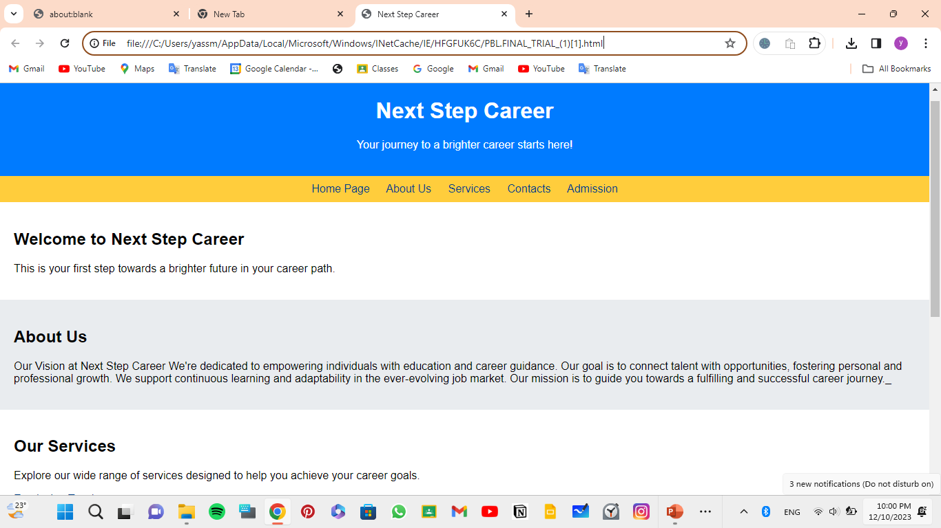
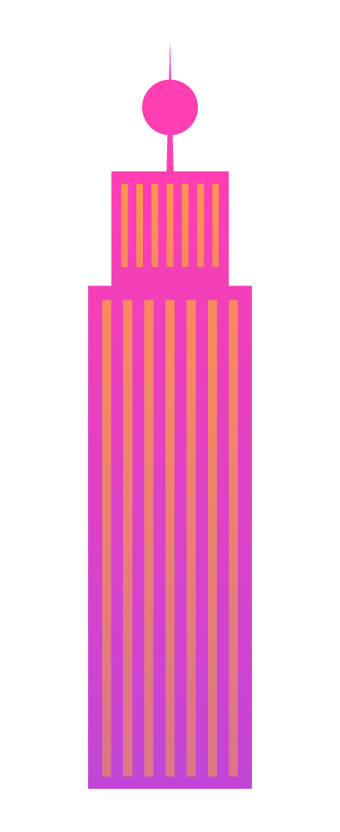
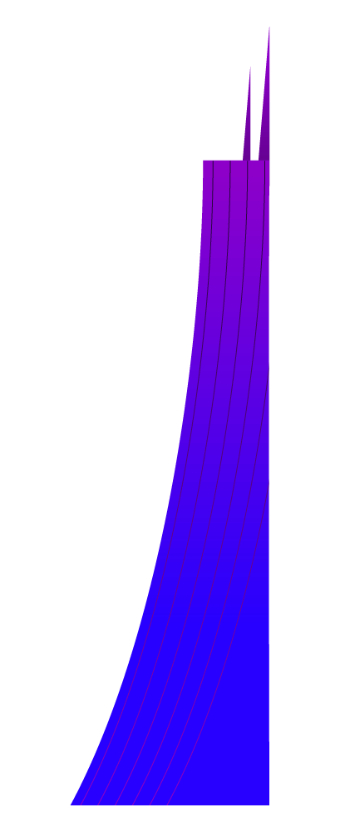
NEXT.STEP.CAREER
This website is a solution we came up with to solve unemployment. This website has easy access and you can find loads of jobs on there, but sadly unemployment is not our only problem

Slide 8
what is Poverty:
What are the causes of poverty?:
Poverty is a state or condition in which one lacks the financial resources and essentials for a certain standard of living. Poverty can have diverse social, economic, and political causes and effects
Causes of relative poverty include unemployment, poor health, and inequalities within the labor market

Slide 9
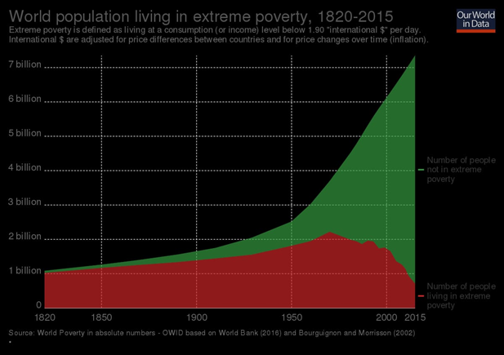
Our goal:
Although the percentage of people living in extreme poverty to the total population was high and decreasing by time, however, there is a lot to do to reduce the absolute number of those people living an extreme poverty.

Slide 10
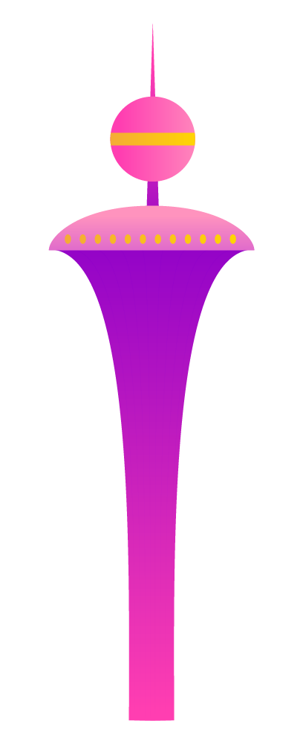
44,000,000
Percentage of poverty in 2023:-
46.9%

Slide 11
03
Architecture

Slide 12
04
Health

Slide 13
05
Technology

Slide 14
Current situation & problems statement
Current situation
The society is an illusion of a perfect utopian world
1
3
A dystopia is an imagined universe in which oppressive societal control or an apocalypse has created a world in which the conditions of life are miserable.
Propaganda is used to control the citizens of society
The society is an illusion of a perfect utopian world
2

Slide 15
Hypothesis
Hypothesis 1
Hypothesis 3
Citizens are truly free to think independently
Citizens have no fear of the outside world
Hypothesis 2
Hypothesis 4
Citizens live in a harmonious state
The natural world is embraced and revered

Slide 16
Awesome words

Slide 17
Theoretical framework
Theoretical framework
Key terms
Relevant theories
Mercury is small
Earth harbors life
Jupiter is quite big
Theory 1
Theory 2
Saturn is a gas giant and has rings.
Neptune is the fourth-largest planet by diameter
Our framework
Venus has a beautiful name and is the second planet from the Sun

Slide 18
Schedule
 | Jan | Feb | Mar | Apr | May | Jun
Phase 1
Task 1
Task 2
Phase 2
Task 1
Task 2

Slide 19
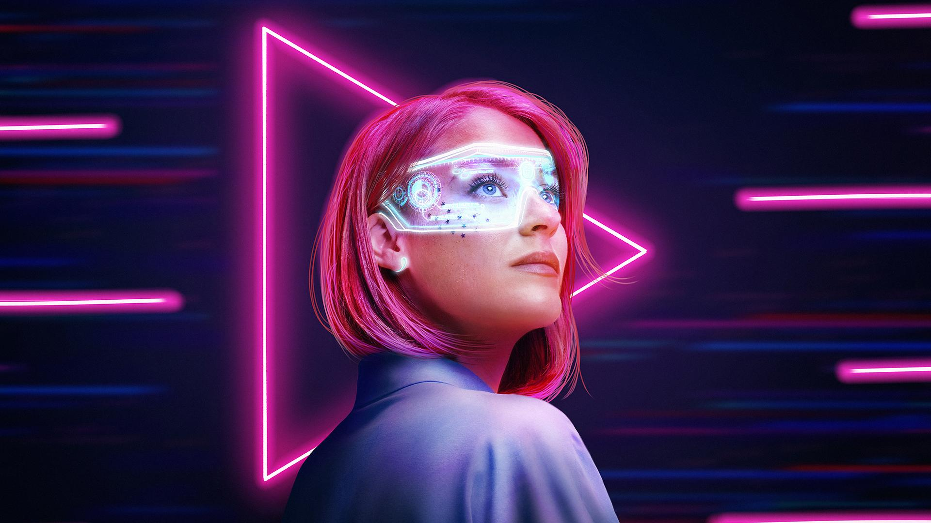
A picture is worth a thousand words

Slide 20
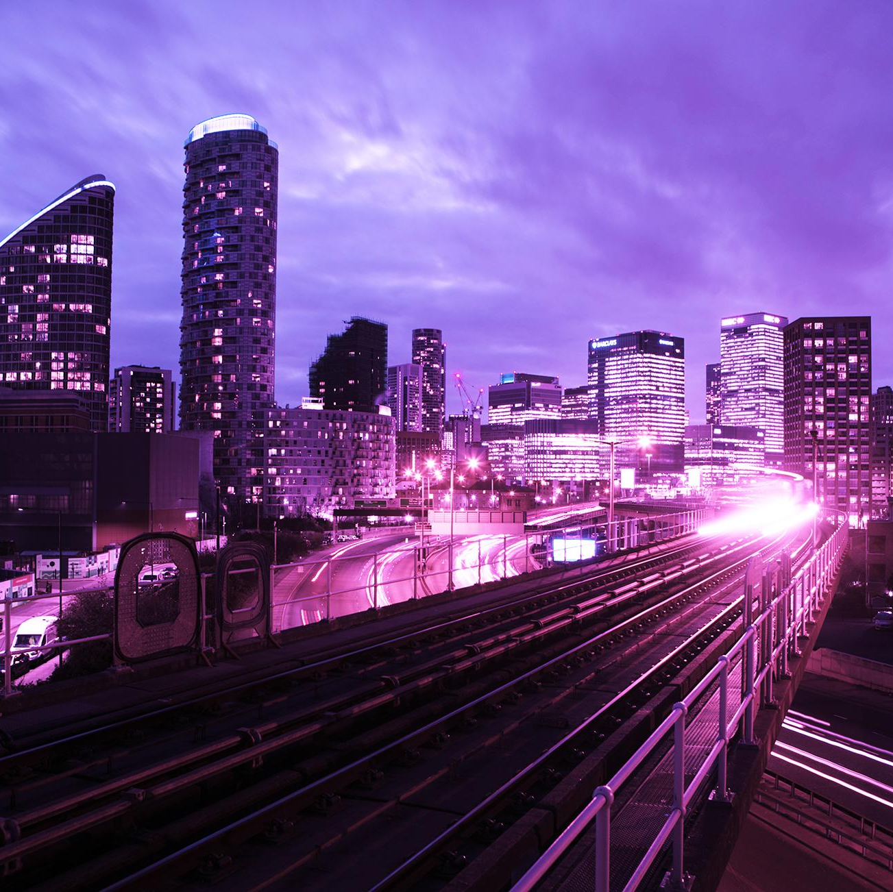
A picture always reinforces the concept
Images reveal large amounts of data, so remember: use an image instead of a long text. Your audience will appreciate it

Slide 21
Map
Cinematography about utopia
Venus is the second planet from the Sun
506
303
155
75

Slide 22
Methodology
Type of data
Data collection
Venus is the second planet from the Sun
Jupiter is the biggest planet in the Solar System
Motives
Specific sampling
Despite being red, Mars is a cold place
Saturn is a gas giant and has several rings

Slide 23
Table
 |  | Test 1 | Test 2 | Test 3
01 | Describe your metrics here
02 | Describe your metrics here
03 | Describe your metrics here
04 | Describe your metrics here

Slide 24
Analysis & development
Phase 01
Phase 02
Mercury is the closest planet to the Sun and the smallest one in the Solar System—it’s only a bit larger than our Moon
Saturn is a gas giant and has several rings. This planet is composed mostly of hydrogen and helium
Venus has a beautiful name and is the second planet from the Sun. It’s terribly hot—even hotter than Mercury
Jupiter is a gas giant, the biggest planet in the Solar System and the fourth-brightest object in the night sky

Slide 25
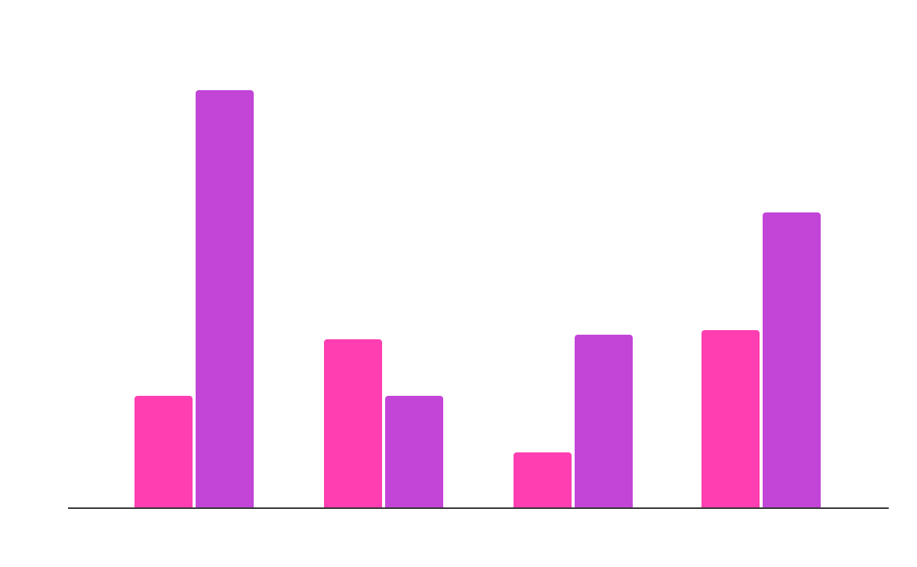
Analysis & development
Mercury is the closest planet to the Sun and the smallest one in the Solar System—it’s only a bit larger than our Moon
The Sun is the star at the center of the Solar System
Jupiter is the biggest planet in the entire Solar System
Mercury
Venus
Follow the link in the graph to modify its data and then paste the new one here. For more info, click here
Mercury is very close to the Sun
Venus has a beautiful name

Slide 26
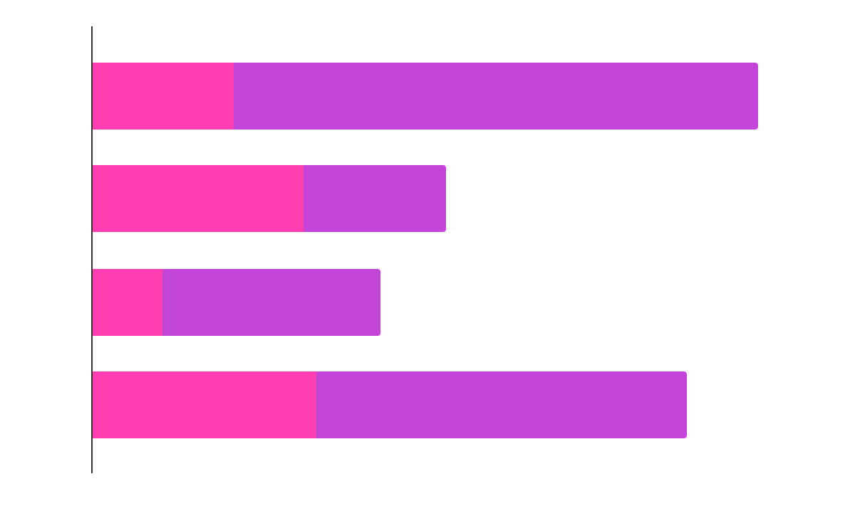
Analysis of the results
Jupiter
Saturn
Jupiter is the biggest planet
Saturn is the ringed planet
Neptune
Neptune is the farthest planet from the Sun
50%
Follow the link in the graph to modify its data and then paste the new one here. For more info, click here

Slide 27
Discussion
Mars
Discussion 1
Despite being red, Mars is actually a cold place. It's full of iron oxide dust, which gives the planet its reddish cast. Earth is the third planet from the Sun and the only one that harbors life in the Solar System. This is where we all live on:
Ceres is located in the main asteroid belt
The Moon is Earth’s natural satellite
Neptune is very far away from us
Pluto is now considered a dwarf planet
Mercury is the closest planet to the Sun and the smallest one in the Solar System—it’s only a bit larger than the Moon
Discussion 2
Venus has a beautiful name and is the second planet from the Sun. It’s terribly hot—even hotter than Mercury

Slide 28
Conclusion
Mercury
Venus
Mercury is the closest planet to the Sun
Venus is the second planet from the Sun
Mars
Jupiter
Saturn
Despite being red, Mars is very cold
Jupiter is the biggest planet of them all
Saturn is composed of hydrogen and helium

Slide 29
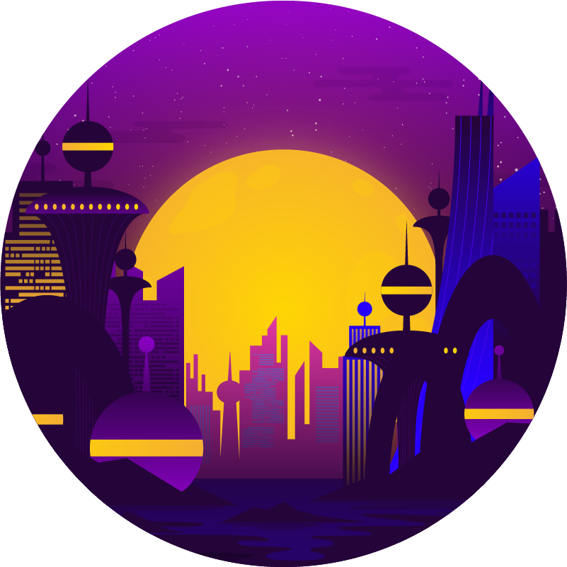

Bibliographical references
Do you know what helps you make your point clear? Lists like this one:
They’re simple
You can organize your ideas clearly
You’ll never forget to buy milk!
And the most important thing: the audience won’t miss the point of your presentation at all. Let’s use lists

Slide 30
Thanks!
Do you have any questions?
youremail@freepik.com
+34 654 321 432
yourwebsite.com
Please keep this slide for attribution

